Slide 1
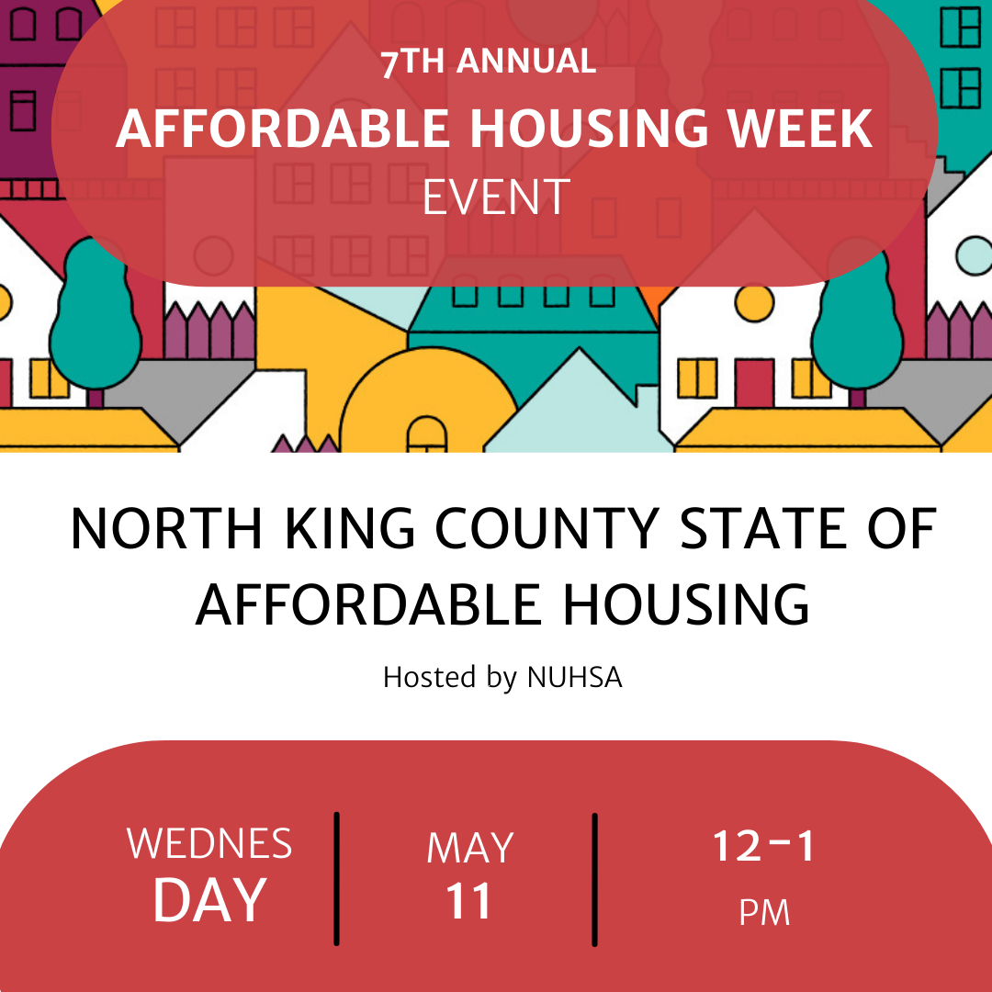
Welcome!
Thank you for joining us today.

Slide 2
Housing Development Consortium (HDC) builds, sustains and inspires a diverse network committed to producing, preserving and increasing equitable access to affordable homes.
North Urban Human Services Alliance (NUHSA) advocates for a strong and accessible system of health and human services in North King County through partnership and collaboration.

Slide 3
If you could please….
Rename
Rename your screen image with your name and the city you are from/representing (or organization).
Introduce
Introduce yourself in the chat (name/ organization).
Note
Note in the chat if there is a particular area/issue you are interested in.
(e.g. ‘middle housing’, ADU/DADU, tenant protections, senior housing, MFTE, low-income housing, zoning amendments)

Slide 4
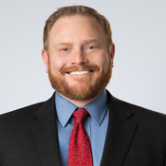
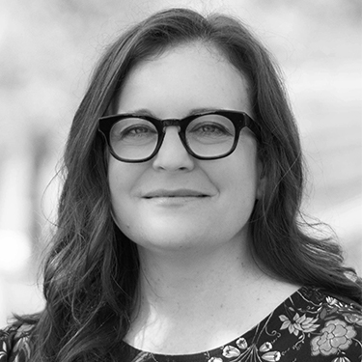
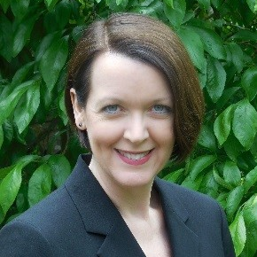
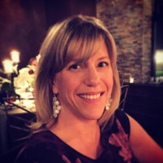
KENMORE
Mayor Nigel Herbig
Stephanie Lucash, Assistant City Manager & American Rescue Plan Act Administrator
SHORELINE
Deputy Mayor Betsy Robertson
Bethany Wolbrecht-Dunn, Community Services Manager
Kerry Freeman, Housing & Human Services Coordinator

Slide 5
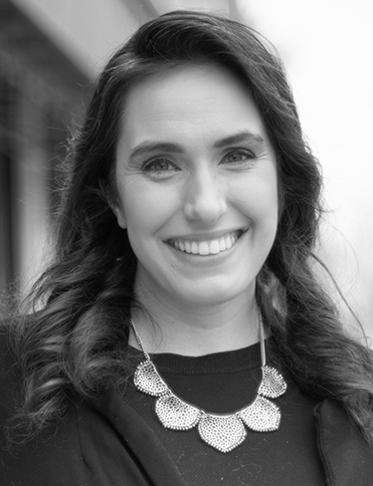
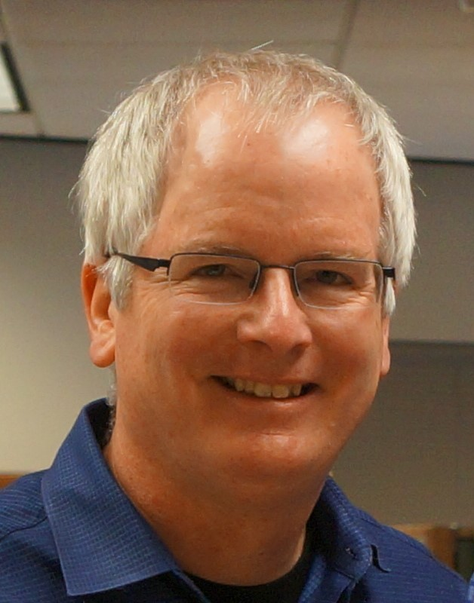
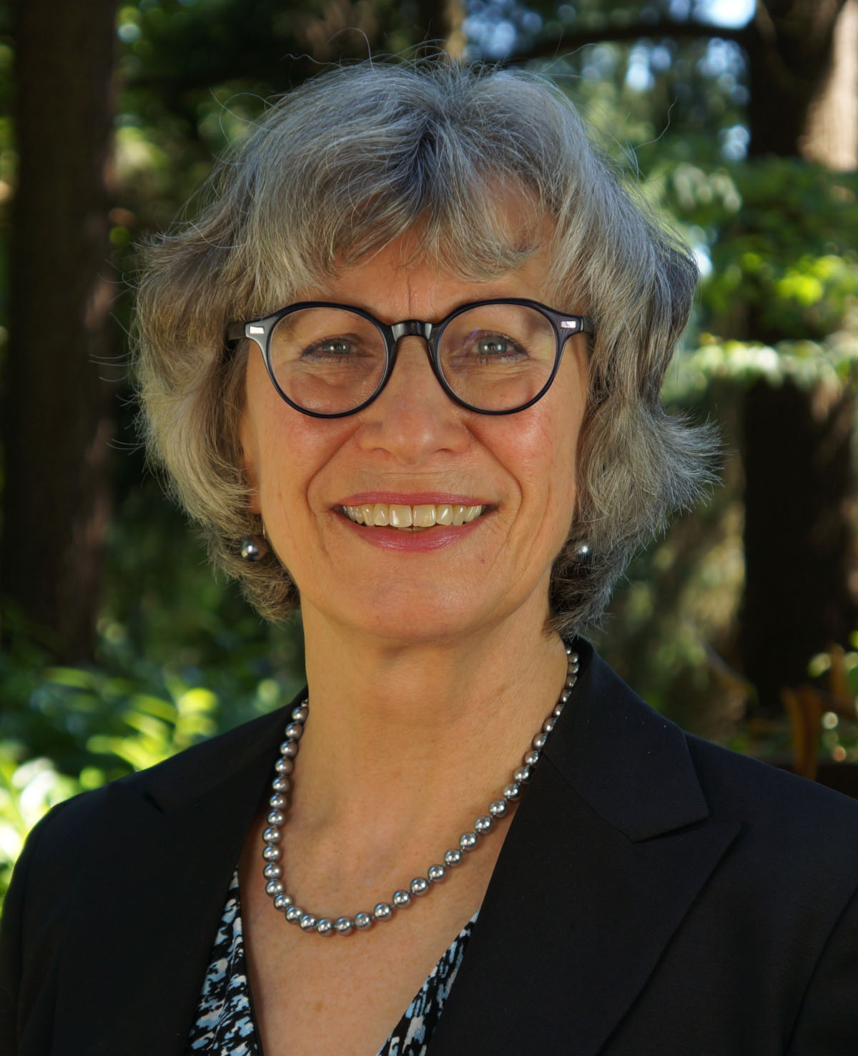
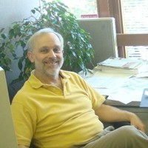
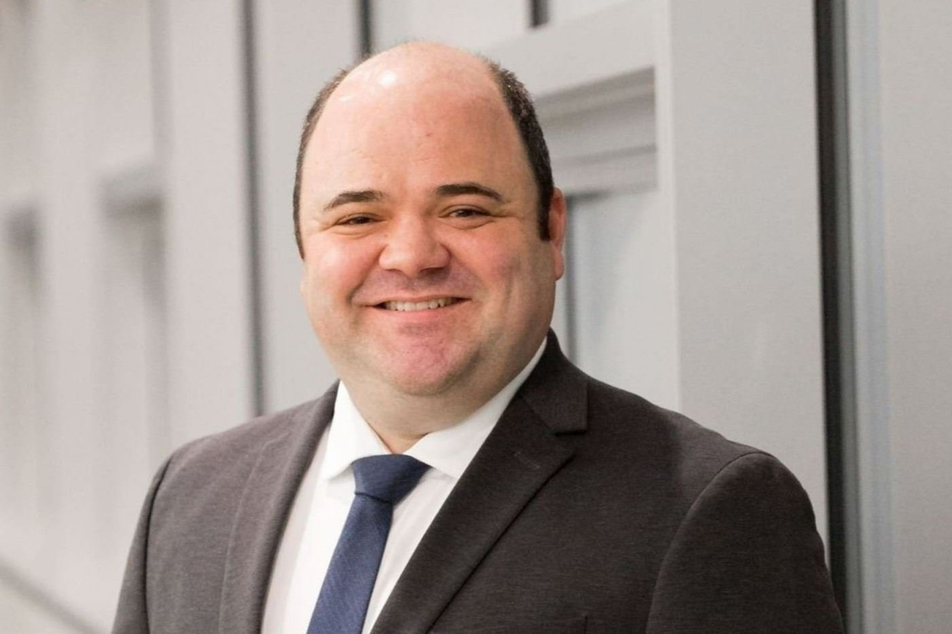
Bothell
Mayor Mason Thompson
Council Member Jenne Alderks
Dave Boyd, Senior Planner
Lake Forest Park
Council Member Phillippa Kassover
Steve Bennett, Planning Director

