Slide 1
Affordable Housing in Bothell
NUHSA Forum
May 11, 2022
Past & Recent: Mobile homes, Inclusionary zoning, MFTE
Ongoing & Upcoming: Middle housing, parking reductions, additional inclusionary zones
Mayor Mason Thompson
Councilmember Jenne Alderks
Senior Strategic Planner Dave Boyd

Slide 2
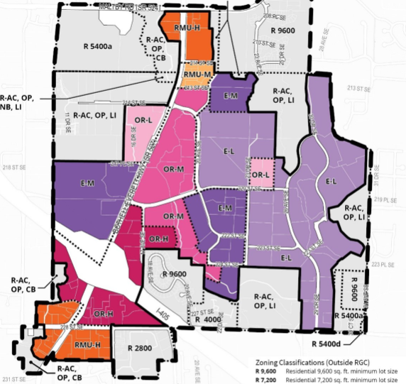
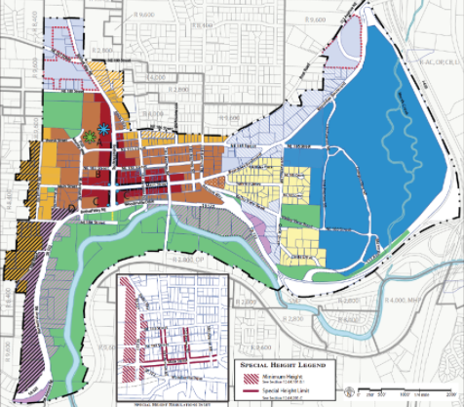
Affordable Housing
Past and recent efforts
Existing areas
DT AH Overlay
GDC AH Overlay
522 AH Incentive Overlay
MHP Overlay
522 AH Overlay
Downtown
Canyon Park: Affordability required in colored ‘R’ zones

Slide 3
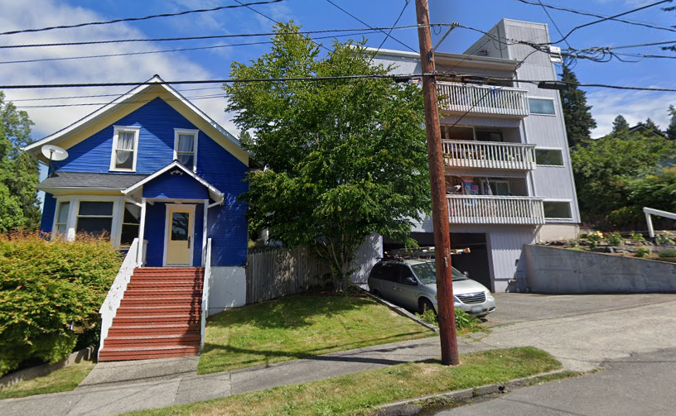
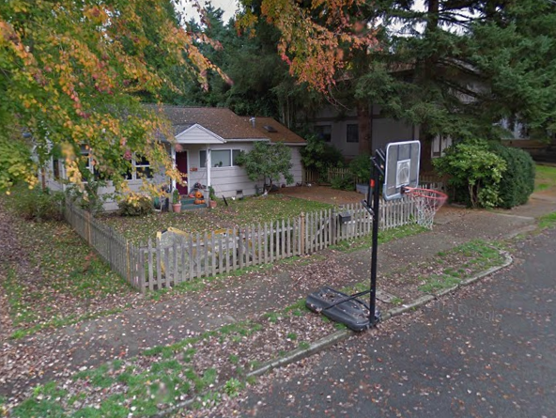
Ongoing Middle Housing Code Amendments
Housing Strategy Priorities
Regulatory Flexibility for Innovative Housing including carriage houses or cottages, townhouses, and house-scale multiplexes in SF zones
Affordable Housing with Capacity Increases
Affordable Housing for Families

Slide 4
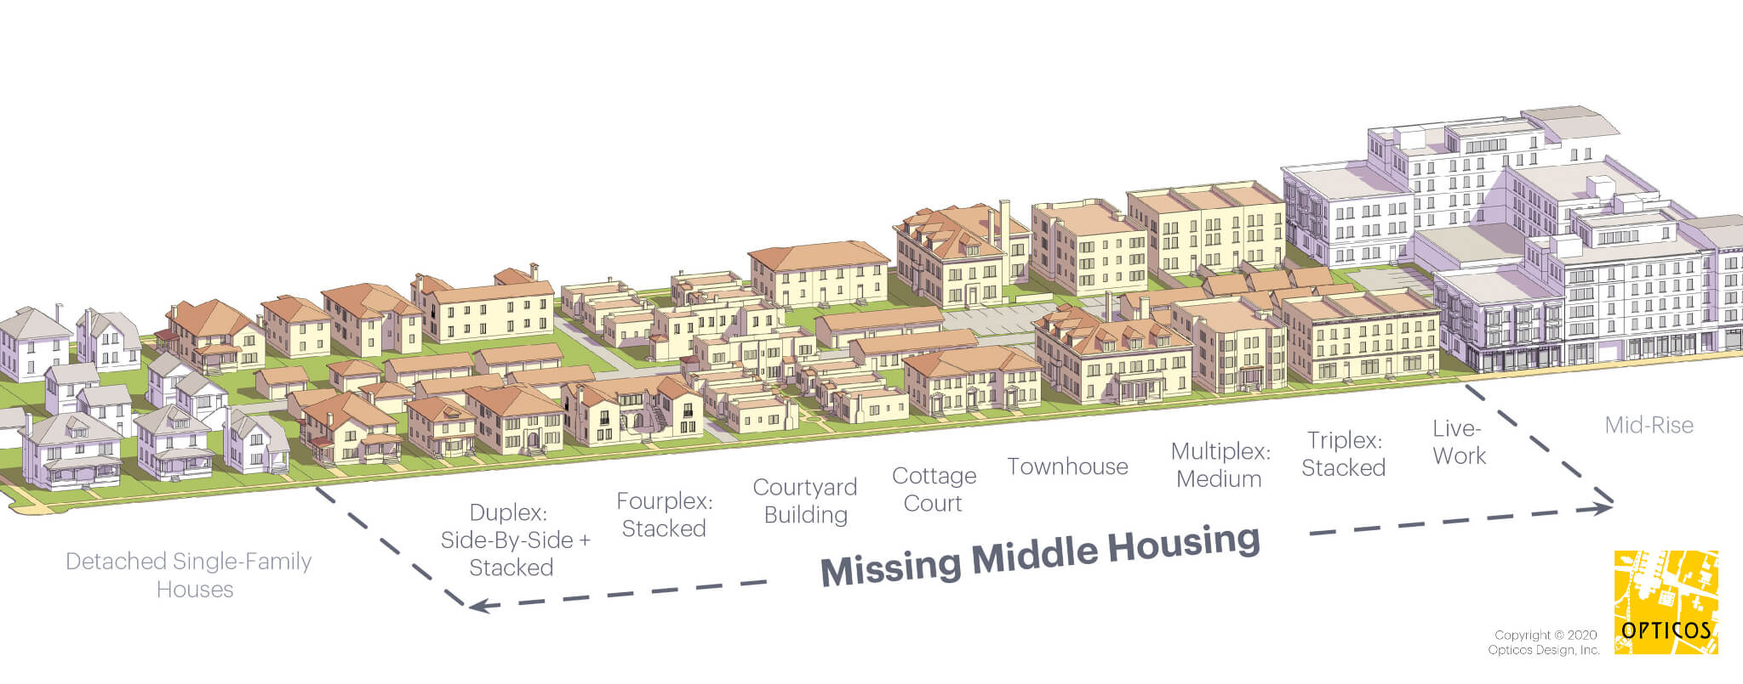
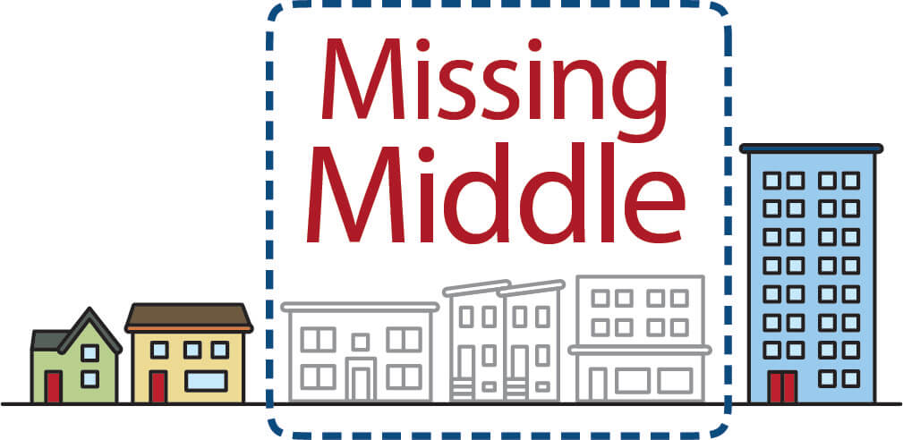
Middle Housing: Community Forum 6pm 5/31
House-scale buildings w/ multiple units in walkable neighborhoods
Fills a need for housing in between single-family homes & large apartments
Alliance for Housing Solutions, Arlington VA
missingmiddlehousing.com
Could form a transitional zone, or be scattered through a single-family area

Slide 5
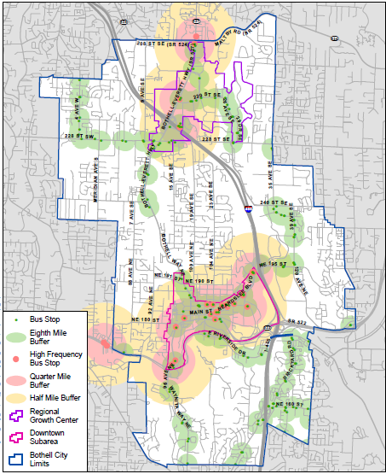
Parking Reductions
with affordable housing requirements
Near frequent existing & future transit
Sound Transit Bus Rapid Transit
Extension of Swift Green Line
Consider also areas we want to get better transit

Slide 6
Proposed 2022 up-zones
with affordable housing requirements
All private proposals to add residential capacity
All request reduced parking
Continued work w/ ARCH to develop affordable housing requirements and/or incentives
Recent direction to work w/ partnership on affordable housing on City-owned downtown parcel

